Slide 1
Database Management System Laboratory
PROJECT PRESENTATION

Slide 2
MEMBERS
Safi Ul Sahid ID: 011151289

Slide 3
Project Title
IMDB-UIU

Slide 4
Project Description
IMDB-UIU is a movie database of information related to films including cast, writer, director, production company rating operated by admins and users.
The site enables registered users to submit new information and lm related materials and edit the existing information. users are also invited to rate any lm on a scale of 1 to 10 and the totals are converted into mean-rating that is displayed beside each title.
anyone can view the lm information. a registration process is necessary however to contribute information to the site.

Slide 5
Project Features
The IMDB-UIU offers a rating scale that allows users to rate films on a scale of 1 to 10
The site indicates that submitted rating are filtered and weighted in various ways in order to produce a weighted mean that is displayed for each film.
Users can write comment for every movie in the comment section of the film.
The site top 50 list is a listing for the top rated 50 films based on rating by registered users.
Users can search movies by the title of the movie and can see the information of the movie.

Slide 6
Entity Relationship Diagram(ERD)
There are 8 entity tables including user table.
There are 9 relationship tables
There are 17 tables in total
User table is only for login system of the website but not related to the movie
The other 7 entities are movie, person, production, genre, language, country, location
The 9 relation tables are writer, director, cast, produce, movie_genre, movie_language, movie_country, movie_location, country_location

Slide 7
Entity Relationship Diagram(ERD)
Movie is related to person by 3 different relation like writer, director and cast
Movie is relation to the production by produce
Movie is related to genre by movie_genre relation table
Movie is relatd to the language table by movie_language
Movie is related to the country by movie_country
Movie is related to the location by movie_location

Slide 8
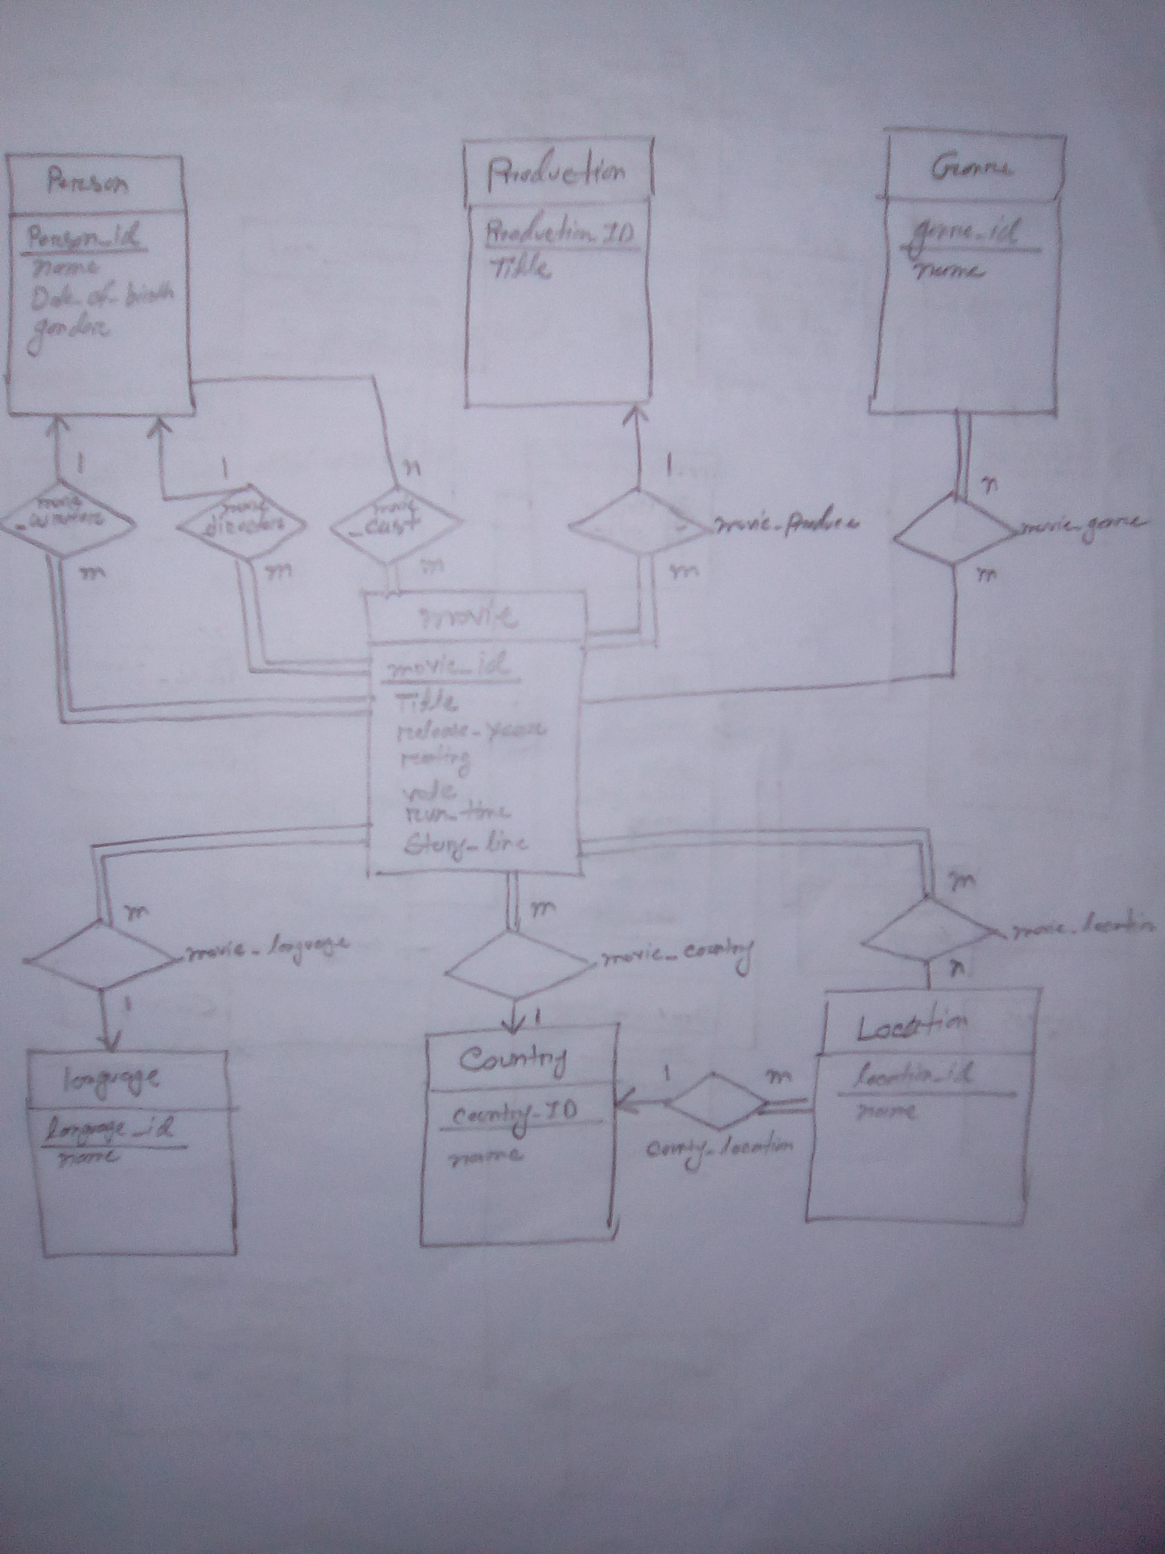
Entity Relationship Diagram(ERD)

Slide 9
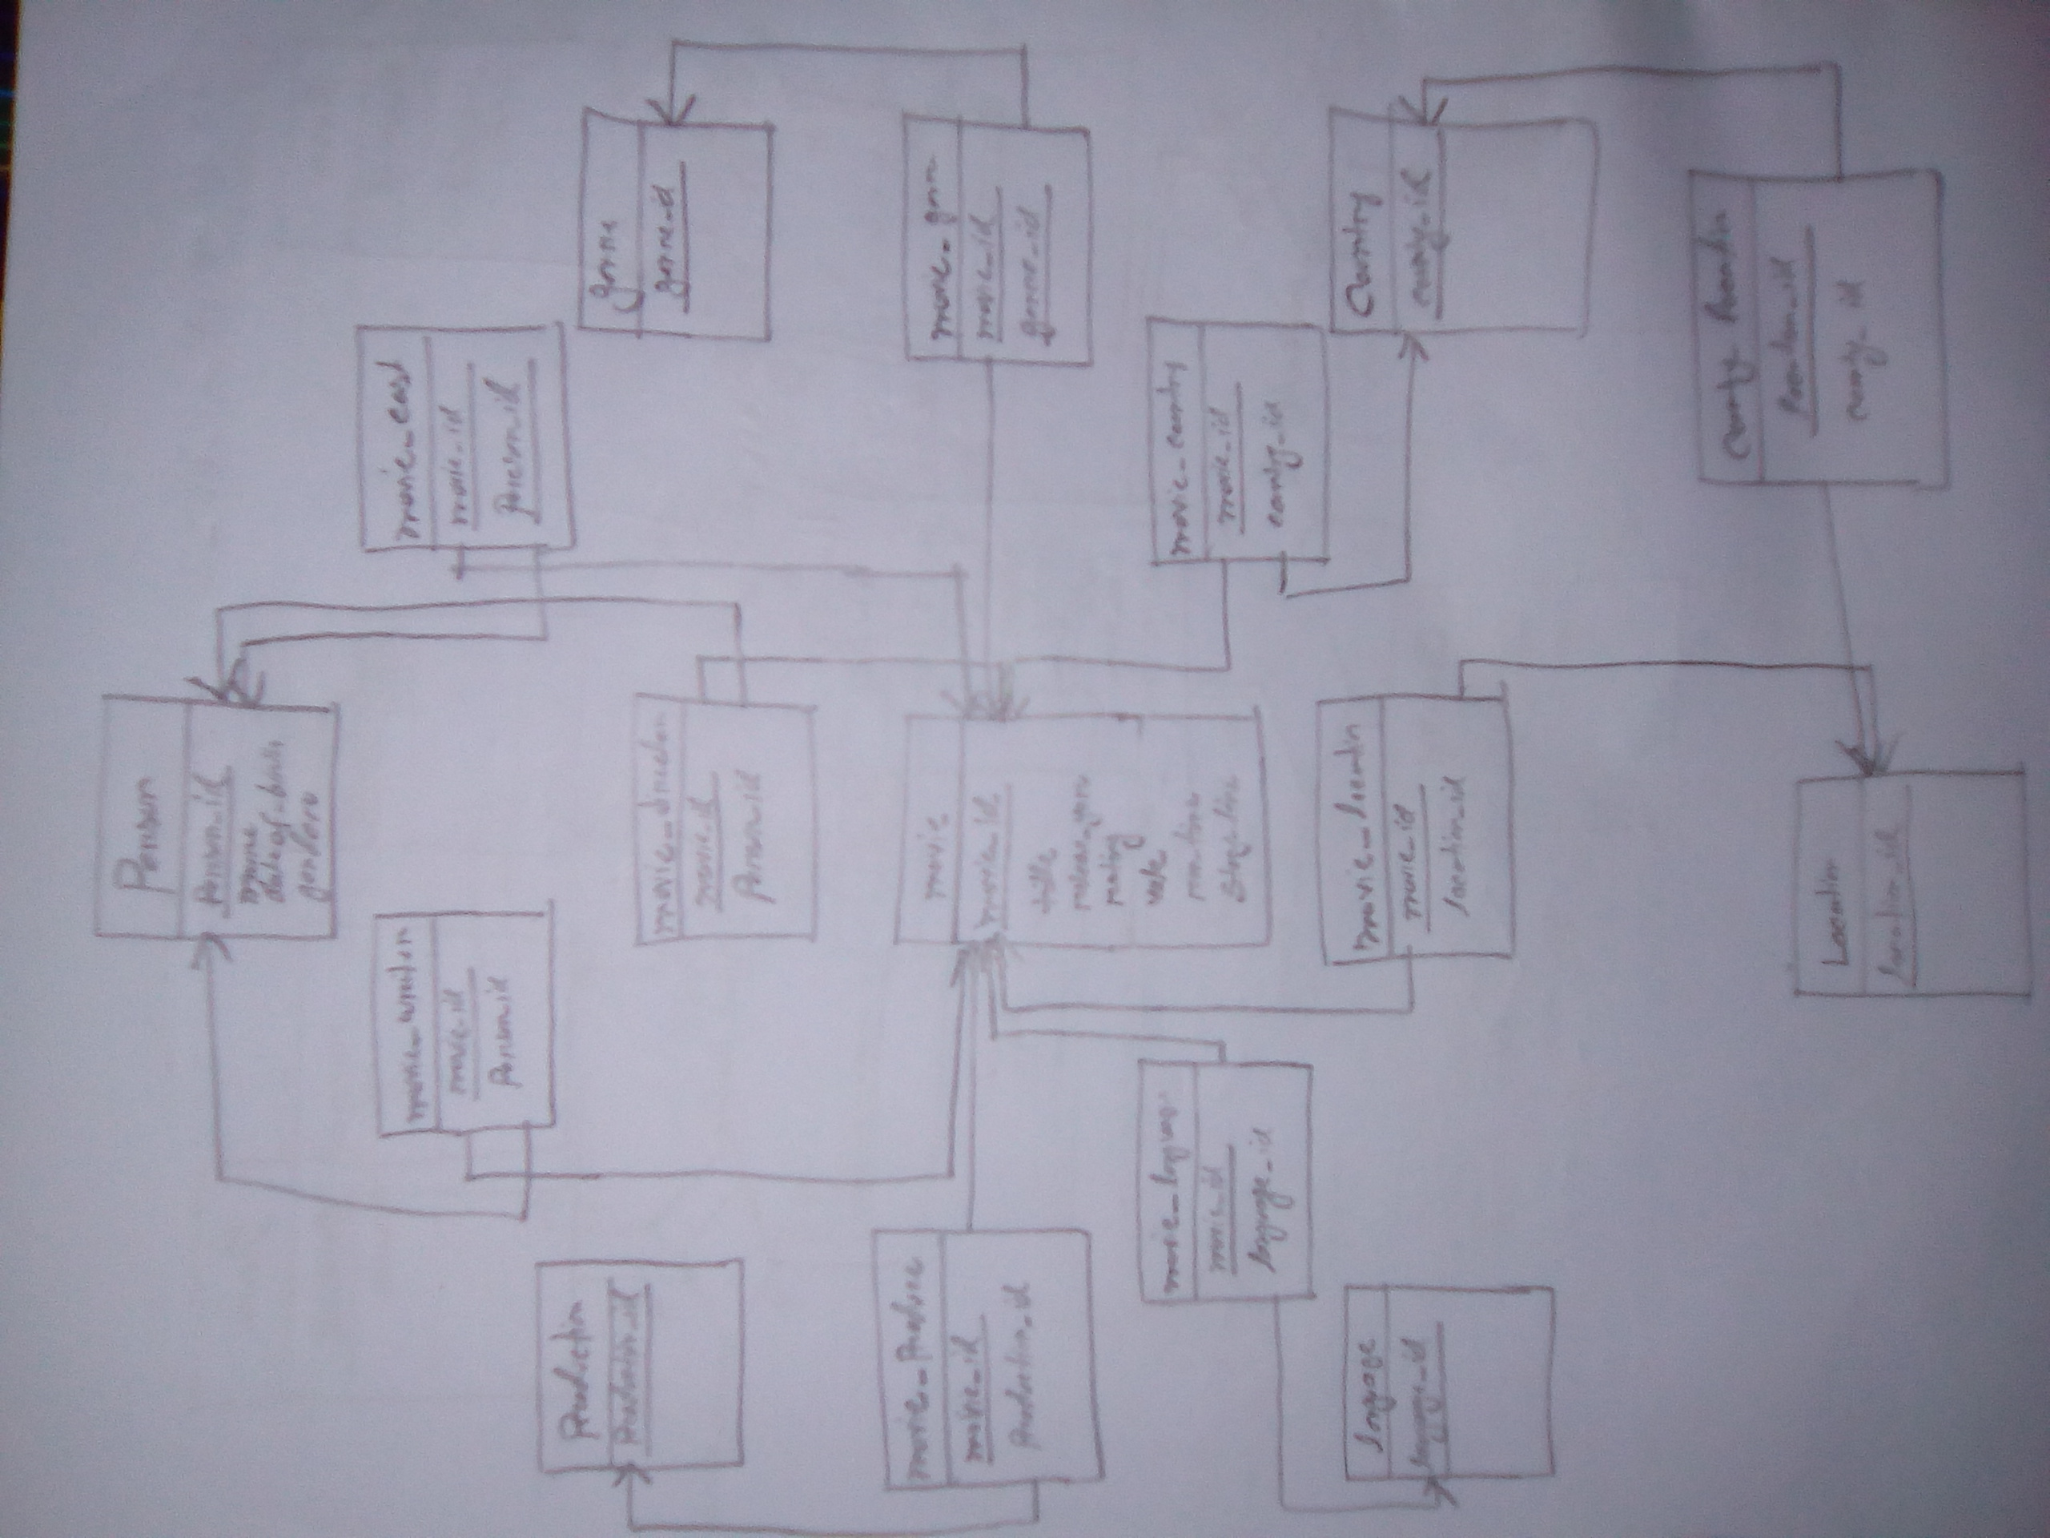
Schema Diagram

Slide 10
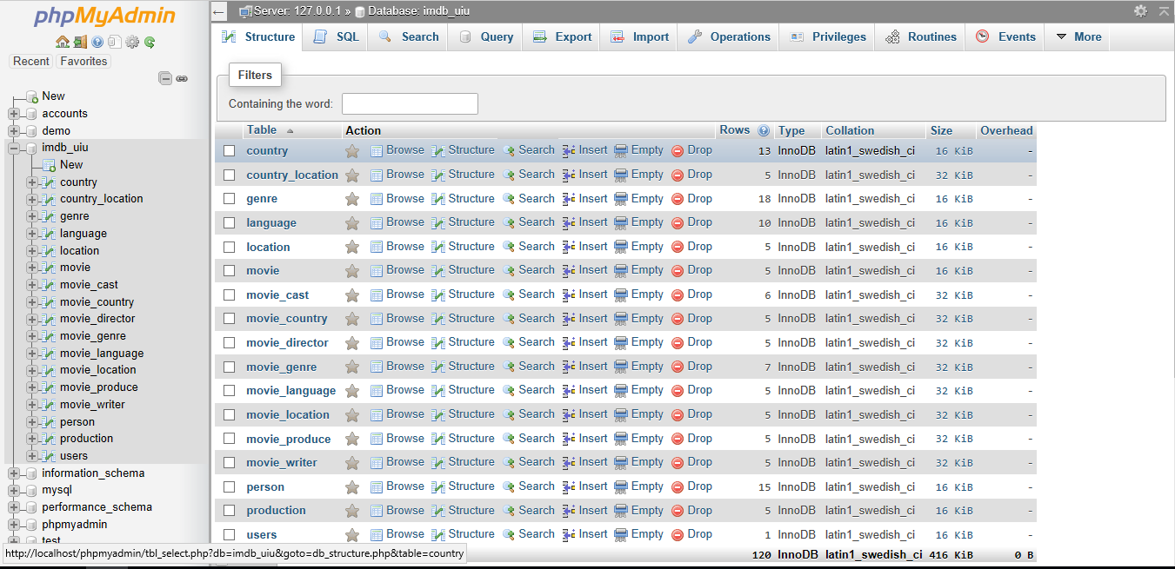
DATABASE TABLES

Slide 11
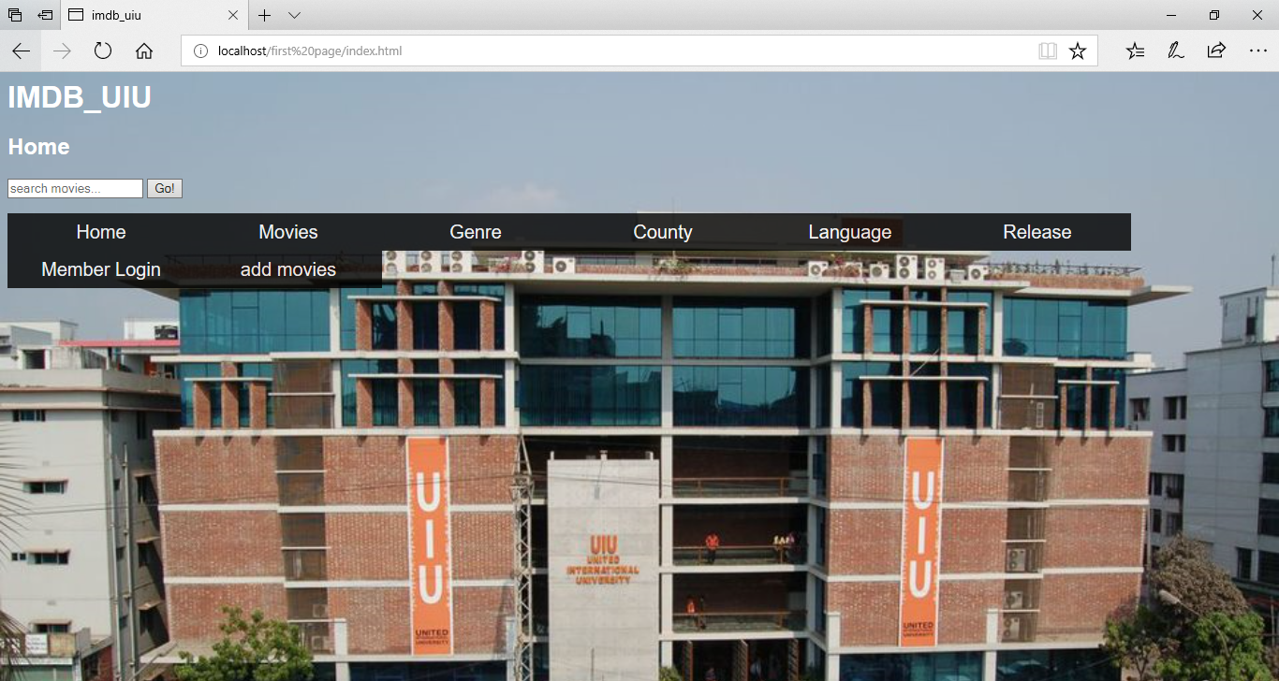
HOME

Slide 12
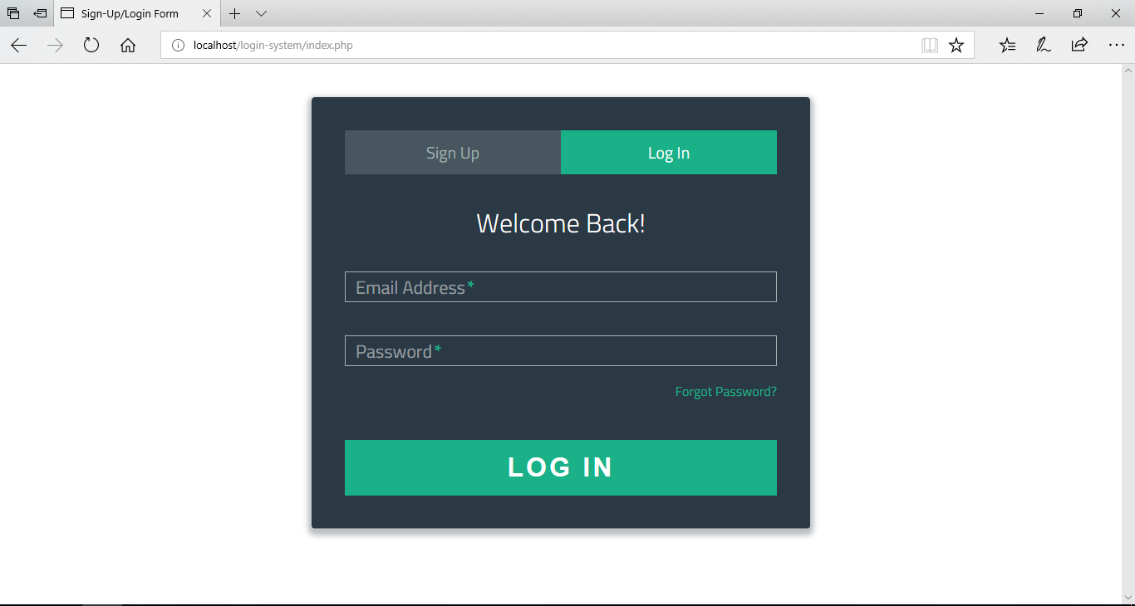
LOGIN SYSTEM

Slide 13
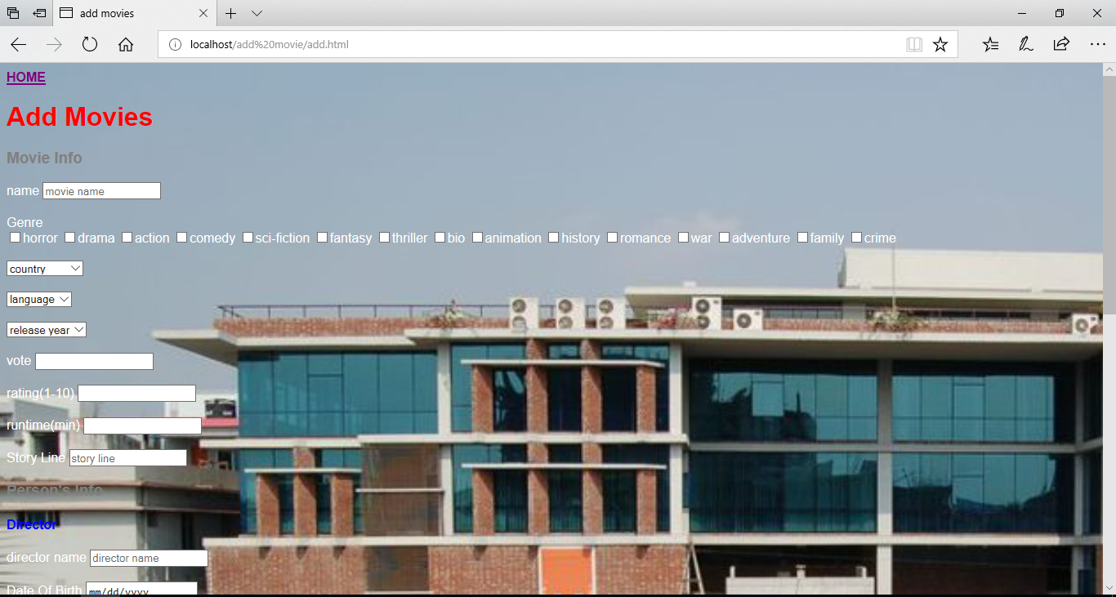
ADDING MOVIE INFO FORM

Slide 14
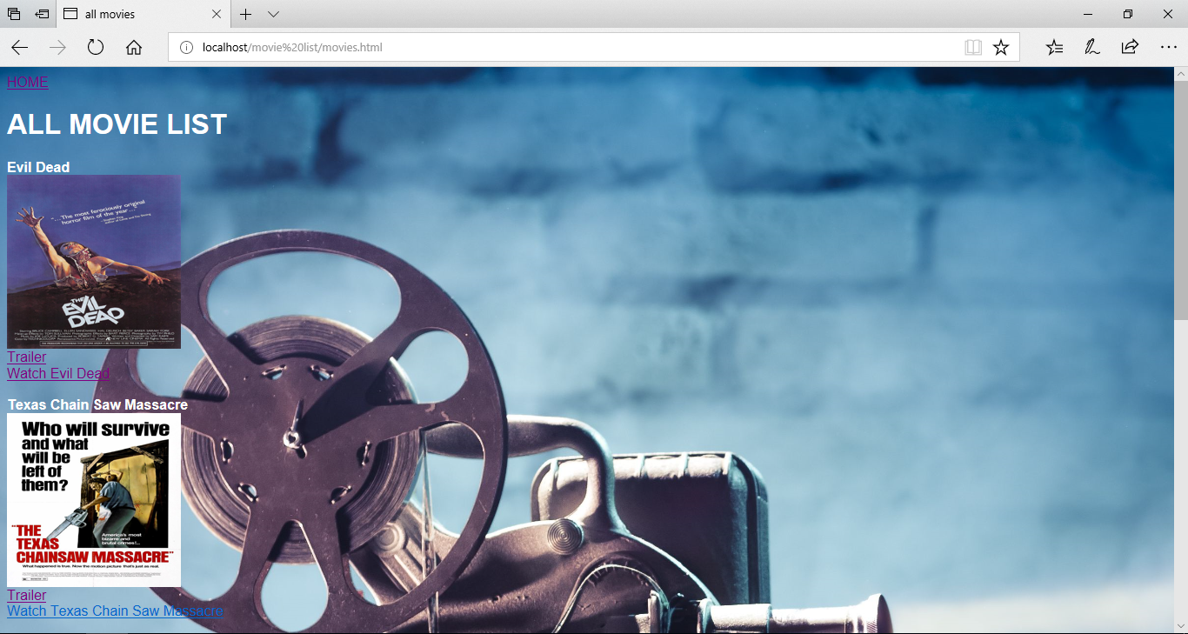
ALL MOVIE LIST PAGE

